Slide 1

AWS Compute services
Lesson 03: AWS Compute services
Notes:
Add instructor notes here.

Slide 2
Lesson Objectives
In this lesson, you will learn:
Amazon EC2
Auto Scaling
Elastic Load balancing
Notes:
Amazon EC2
Auto Scaling
Elastic Load balancing
This lesson is to give an Introduction on Java Server Pages

Slide 3
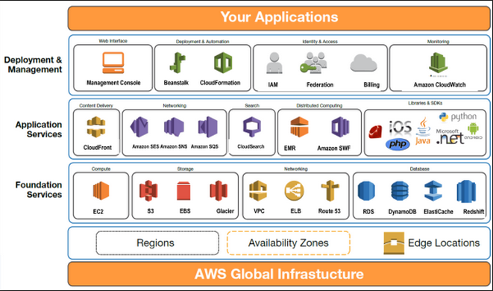

3.1: Amazon EC2 AWS 360⁰ View

Slide 4
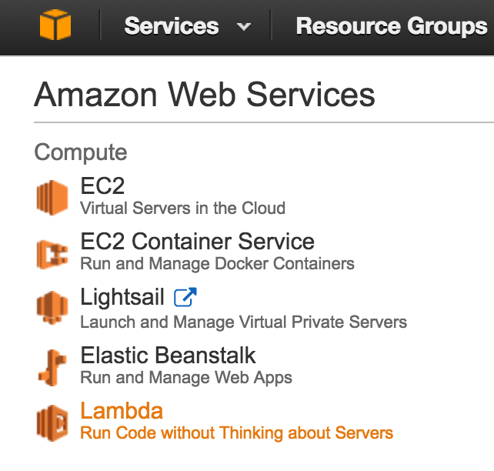
3.1: Amazon EC2 AWS 360⁰ View

Slide 5
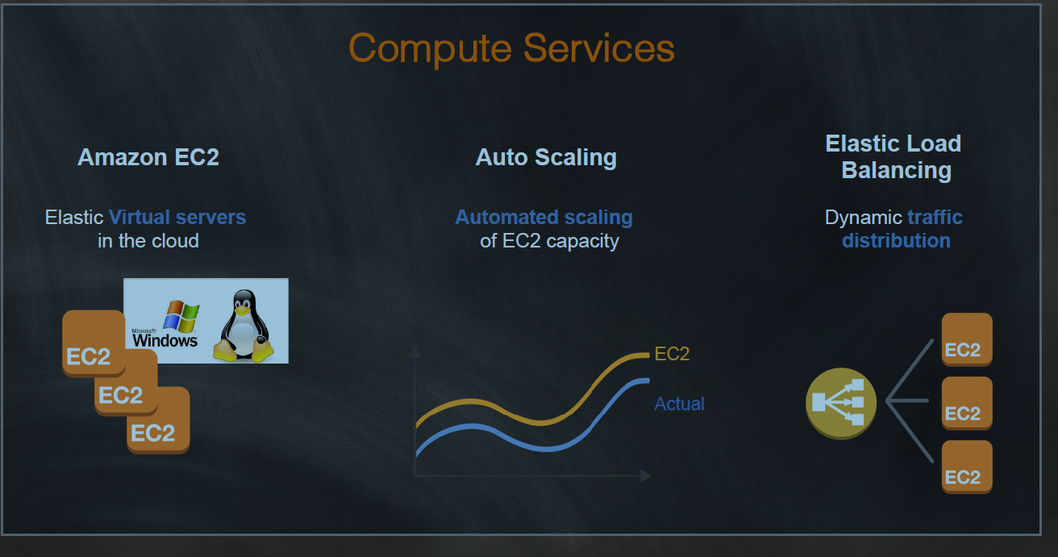
3.1: Amazon EC2 Compute Services

Slide 6

3.1: Amazon EC2 Amazon Web Services Cloud Platform
AWS is a comprehensive cloud services platform that offers
compute power
storage
content delivery
and other functionality
organizations can use to deploy applications and services cost-effectively—with flexibility, scalability, and reliability.
As per the requirement, one can proactively address the
internal plans and react to external demands when you
choose .
Notes:
AWS is a comprehensive cloud services platform that offers compute power, storage, content delivery, and other functionality that organizations can use to deploy applications and services cost-effectively—with flexibility, scalability, and reliability. AWS self-service means that you can proactively address your internal plans and react to external demands when you choose

Slide 7
3.1: Amazon EC2 Amazon EC2
Amazon EC2 – Amazon Elastic Compute Cloud
It is a web service which provides resizable compute capacity in the cloud.
It is designed to make web-scale computing easier for developers and system administrators.
Amazon EC2’s simple web service interface allows you to obtain and configure capacity with minimal friction
Notes:
(Amazon EC2) is a web service that provides resizable compute capacity in the cloud. It is designed to make web-scale computing easier for developers and system administrators.
Amazon EC2’s simple web service interface allows you to obtain and configure capacity with minimal friction. It provides you with complete control of your computing resources and lets you run on Amazon’s proven computing environment. Amazon EC2 reduces the time required to obtain and boot new server instances to minutes, allowing you to quickly scale capacity, both up and down, as your computing requirements change. Amazon EC2 changes the economics of computing by allowing you to pay only for capacity that you actually use. Amazon EC2 provides developers and system administrators the tools to build failure resilient applications and isolate themselves from common failure scenarios.

Slide 8
3.1: Amazon EC2 Amazon EC2
It provides you with complete control of your computing resources and lets you run on Amazon’s proven computing environment.
Amazon EC2 changes the economics of computing by allowing you to pay only for capacity that you actually use.
It could be a virtual machine in Cloud . it could be a virtual Linux machine , window system in Server.
It gives complete environment setup .
A dynamic website uses server-side processing to build
pages that are customized to visitor's requests
Notes:
(Amazon EC2) is a web service that provides resizable compute capacity in the cloud. It is designed to make web-scale computing easier for developers and system administrators.
Amazon EC2’s simple web service interface allows you to obtain and configure capacity with minimal friction. It provides you with complete control of your computing resources and lets you run on Amazon’s proven computing environment. Amazon EC2 reduces the time required to obtain and boot new server instances to minutes, allowing you to quickly scale capacity, both up and down, as your computing requirements change. Amazon EC2 changes the economics of computing by allowing you to pay only for capacity that you actually use. Amazon EC2 provides developers and system administrators the tools to build failure resilient applications and isolate themselves from common failure scenarios.

Slide 9
3.1: Amazon EC2 Amazon EC2 – Container(ECC)
Dynamic websites require server-side technologies such as PHP, Java, or .NET
Launches a virtual server that runs your web server and performs server-side processing.
You can run your database on this server or on Amazon Relational Database Service (Amazon RDS).
Free Usage - YES
750 hours per month of a t1.micro instance
Notes:
(Amazon EC2) is a web service that provides resizable compute capacity in the cloud. It is designed to make web-scale computing easier for developers and system administrators. Overview of Amazon Web Services March 2013
Page 11 of 22
Amazon EC2’s simple web service interface allows you to obtain and configure capacity with minimal friction. It provides you with complete control of your computing resources and lets you run on Amazon’s proven computing environment. Amazon EC2 reduces the time required to obtain and boot new server instances to minutes, allowing you to quickly scale capacity, both up and down, as your computing requirements change. Amazon EC2 changes the economics of computing by allowing you to pay only for capacity that you actually use. Amazon EC2 provides developers and system administrators the tools to build failure resilient applications and isolate themselves from common failure scenarios.

Slide 10
3.1: Amazon EC2 Amazon EC2 – OPTIONS
On Demand :-
It allows to pay a fixed rate per hours or seconds
Reserved:-
It provides a capacity reservations for 1 Year or 3 Years terms.
SPOT :--
It allows for bidding , whatever price you want as per capacity
Dedicated Hosts:--
Physical EC2 server dedicated for use .
Notes:
(Amazon EC2) is a web service that provides resizable compute capacity in the cloud. It is designed to make web-scale computing easier for developers and system administrators. Overview of Amazon Web Services March 2013
Page 11 of 22
Amazon EC2’s simple web service interface allows you to obtain and configure capacity with minimal friction. It provides you with complete control of your computing resources and lets you run on Amazon’s proven computing environment. Amazon EC2 reduces the time required to obtain and boot new server instances to minutes, allowing you to quickly scale capacity, both up and down, as your computing requirements change. Amazon EC2 changes the economics of computing by allowing you to pay only for capacity that you actually use. Amazon EC2 provides developers and system administrators the tools to build failure resilient applications and isolate themselves from common failure scenarios.

Slide 11
3.1: Amazon EC2 Amazon EC2 – Instance Types
D- Density
R for ram
M for general purpose use for Application server
C for computer means compute optimized
G for graphics
I for increase storage (IOPS)
F – field programming
T2 is lowest cost used web servers
P2 – graphics/ general purpose CPU
X1 for extra large
Notes:
D- Density and 2 – for generation
How to remember tips:
R for ram means memory optimized
M for general purpose use for Application server. When we deploy the app server but we don’t know what this App server will do , then M4 is the main choice.
C for computer means compute optimized
G for graphics intensive used for video encoding/streaming
I for increase storage (IOPS), i.e. high speed storage used (NoSQL db. ,data warehousing etc. )
F – field programming gateway (brand new )Hardware acceleration of code. You can choose hardware.
T2 is lowest cost used web servers , small DB
P2 – graphics/ general purpose CPU, used for Bit coin mining , machine learning etc.
X1 for extra large – extreme memory optimization (SAP , hana etc.)

Slide 12
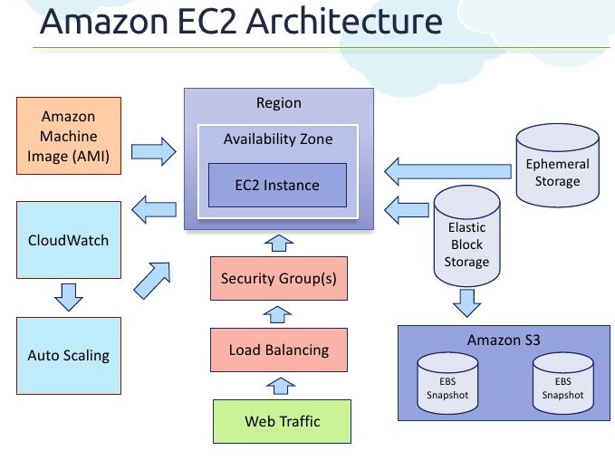
3.1: Amazon EC2 Amazon EC2
Notes:
Click on EC2 Dashboard
Click on Launch Instances

Slide 13
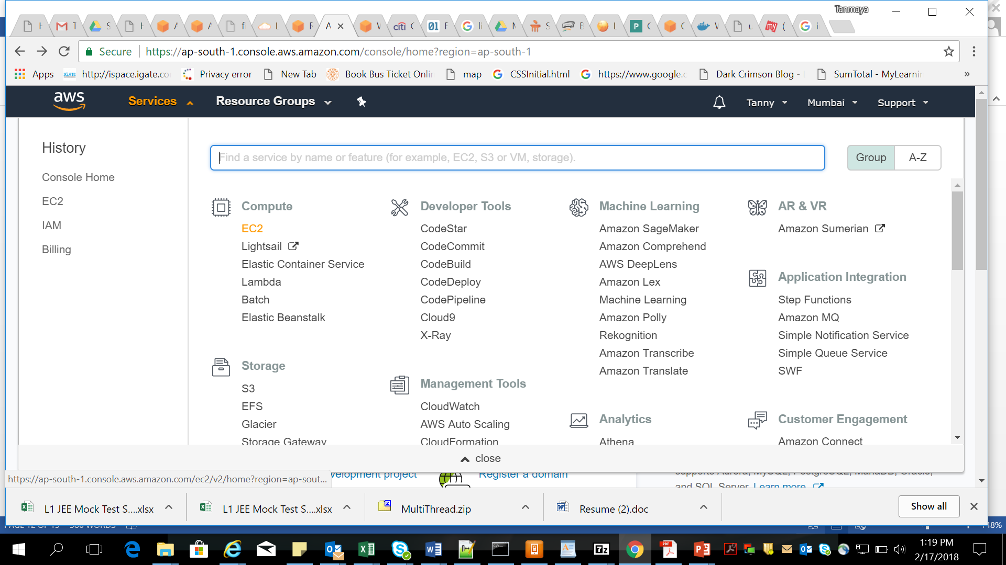
3.1: Amazon EC2 Amazon EC2
Notes:
First Create an Account in AWS .
Click On Services and choose EC2 options

Slide 14
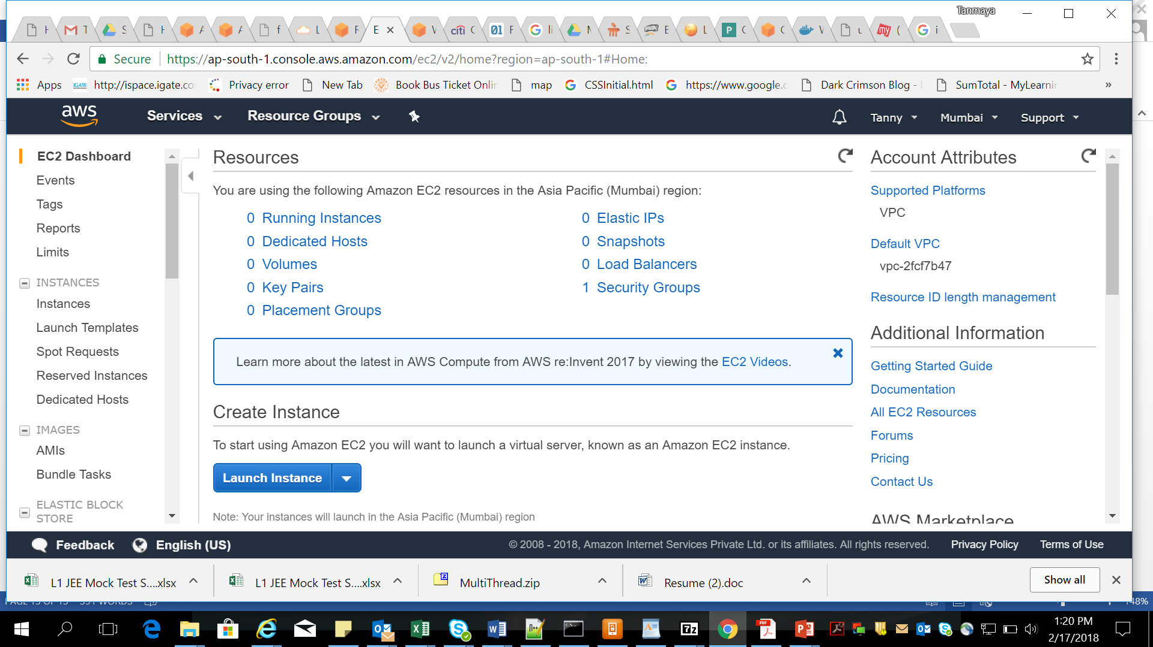
3.1: Amazon EC2 Amazon EC2
Notes:
Click on EC2 Dashboard
Click on Launch Instances

Slide 15
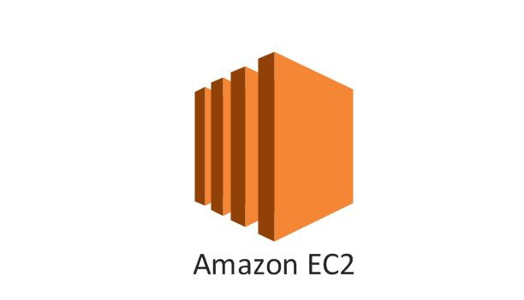
3.1: Amazon EC2 Demo
Demo on:
Creating EC2 instance ( Refer lab book )

Slide 16
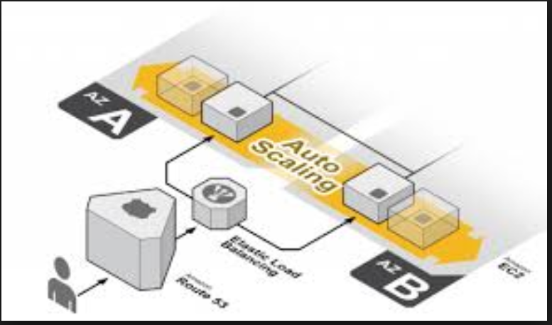
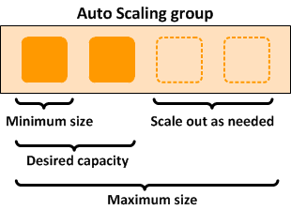
3.2: AWS Auto Scaling Amazon Auto Scaling
Auto Scaling allows you to scale your Amazon EC2 capacity up or down automatically according to conditions you define.
Notes:
Auto Scaling
With Auto Scaling, one can ensure that the number of Amazon EC2 instances are using increases seamlessly during demand spikes to maintain performance, and decreases automatically during demand lulls to minimize costs.
Auto Scaling is particularly well suited for applications which experience hourly, daily, or weekly variability in usage.
Auto Scaling is particularly well suited for applications
that experience hourly, daily, or weekly variability in
usage.

Slide 17
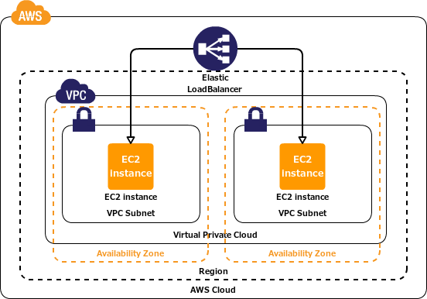
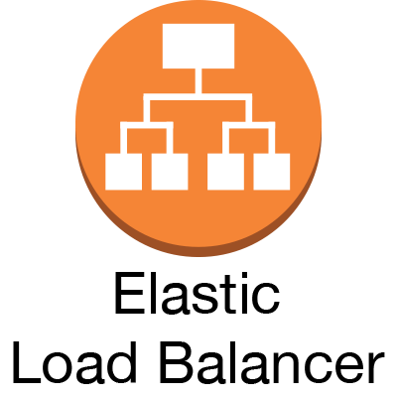
3.3: AWS Elastic Load balancing Amazon Elastic Load balancing
Elastic Load Balancing automatically distributes incoming application traffic across multiple Amazon EC2 instances.
Notes:
Elastic Load Balancing
It enables you to achieve even greater fault tolerance in our applications, seamlessly providing the amount of load balancing capacity needed in response to incoming application traffic.
It detects unhealthy instances and automatically reroutes traffic to healthy instances until the unhealthy instances have been restored.
Customers can enable Elastic Load Balancing within a
single Availability Zone or across multiple zones
for even more consistent application performance.

Slide 18
3.1: Amazon EC2 Demo
Demo on:
Creating AutoScaling on EC2 instance ( Refer lab book )

Slide 19
Summary
In this lesson, you have learnt:
What is Amazon EC2
How to demand Amazon EC2
Amazon Auto scaling
Amazon Auto Load balancing

Slide 20
Review – Questions
Question 1: ___________ could be a virtual machine in Cloud , which could be a virtual Linux machine , window system in Server Using AWS and one can demand compute power, storage, and other services in minutes .
Question 2 : _________ is particularly well suited for applications which experience hourly, daily, or weekly variability in usage.
Notes:
Answers for the Review Questions:
Answer 1: Amazon EC2
Answer 2: Auto Scaling

Slide 21
Review – Questions
Question 3: _________ automatically distributes incoming application traffic across multiple Amazon EC2 instances.
Question 5: Which of the followings are an Amazon EC2 Options?
Option 1 : On demand
Option 2 : SPOT
Option 3 : Reserved
Option 4 : All of the above
Notes:
Answers for the Review Questions:
Answer 3 Elastic Load Balancing
Answer 4: Option 4

